Slide 1
Helping students find their way
Group 1 -
Jeremy, Ang, Hillary, Kellsy

Slide 2
Have you ever felt lost on campus?
Where is this classroom? I’ve never seen it in my life.
We have a clinic on this campus?
Where are these arrows pointing to on these signs?
Where the heck are the washrooms I don’t have time for this!
Notes:
Please raise your hand if you’ve ever experienced any or all of these

Slide 3
UTM Buildings
01
03
Davis Building
Deerfield
UTM’s largest academic building.
Four floors, mostly labs
02
04
Kaneff
Maanjiwe Nandemowinan
Do you know where KN L1230 is?
Newest building, with 6 floors

Slide 4

Target Users

Slide 5
Research Process
Find out what makes indoor navigation difficult
Come up with a design proposal which addresses these problems
Secondary
Analysis
Look at what other places/universities do.
Process the data and make meaningful connections
Primary (Surveys & Interviews)
Ideation

Slide 6

Secondary
Research
Secondary

Slide 7
Secondary Research
Secondary
Mapping Apps
Mappedin.com, Google Maps
Other Universities
They’re better than ours
Our university
Ours forgot indoor mapping

Slide 8
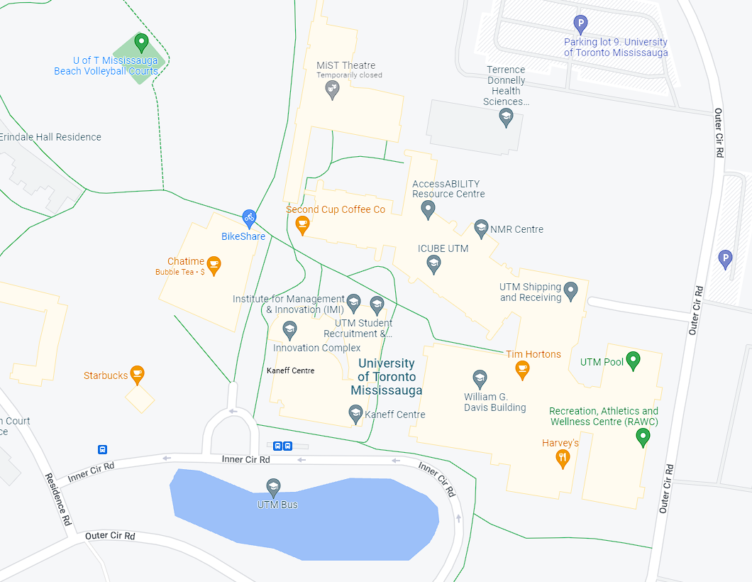
Secondary Research
Mapping Apps: Google Maps
Secondary

Slide 9
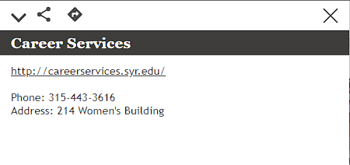
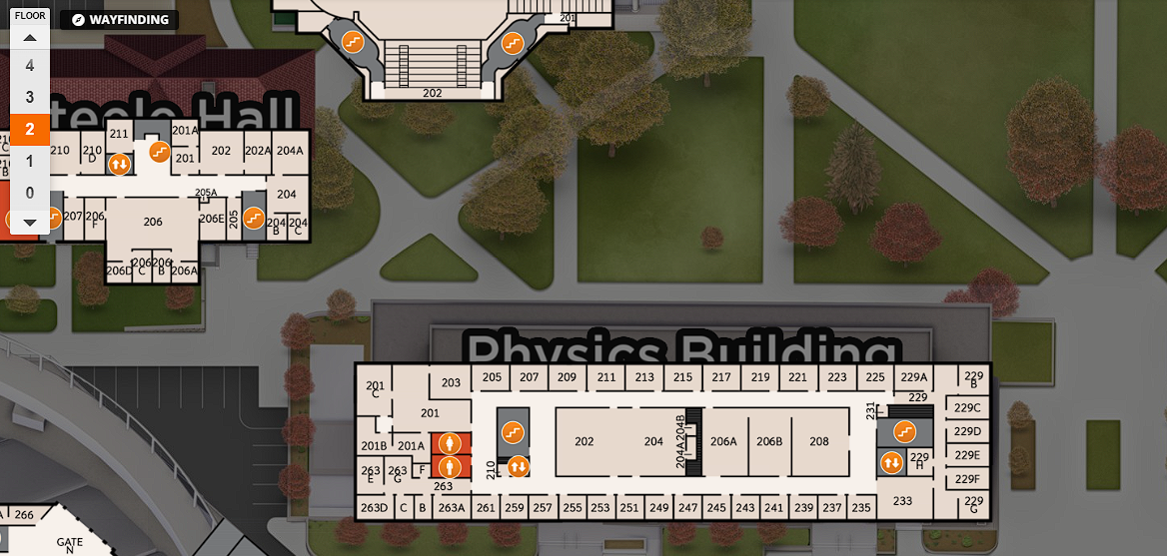
Secondary Research
Other Universities: Syracuse University
Secondary

Slide 10
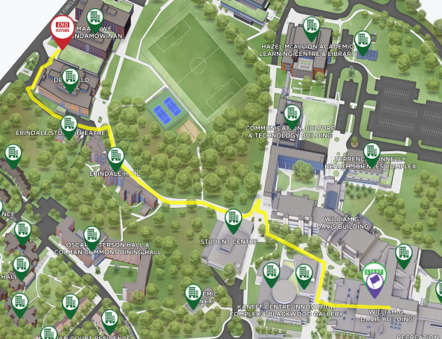
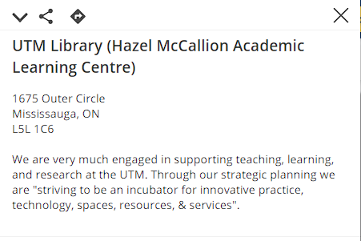
Secondary Research
Our University: map.utoronto.ca
Secondary

Slide 11

Primary
Research
Primary

Slide 12
Primary Research
Primary
Surveys
Interviews
7 participants
13 participants

Slide 13

Primary Research - Surveys
Primary
Surveyed 7 Upper-Year Students
Difficulty Finding Specific Rooms (DV 2046D)
Majority Already Experience Navigating Rooms

Slide 14
Primary Research - Interviews
Primary
Interviewed 5 First and Second Year Students
They Had Little Knowledge of Campus Facilities
Majority Found Signs To Be Confusing
Usually asked for help to find classrooms

Slide 15

Analysis
Analysis

Slide 16
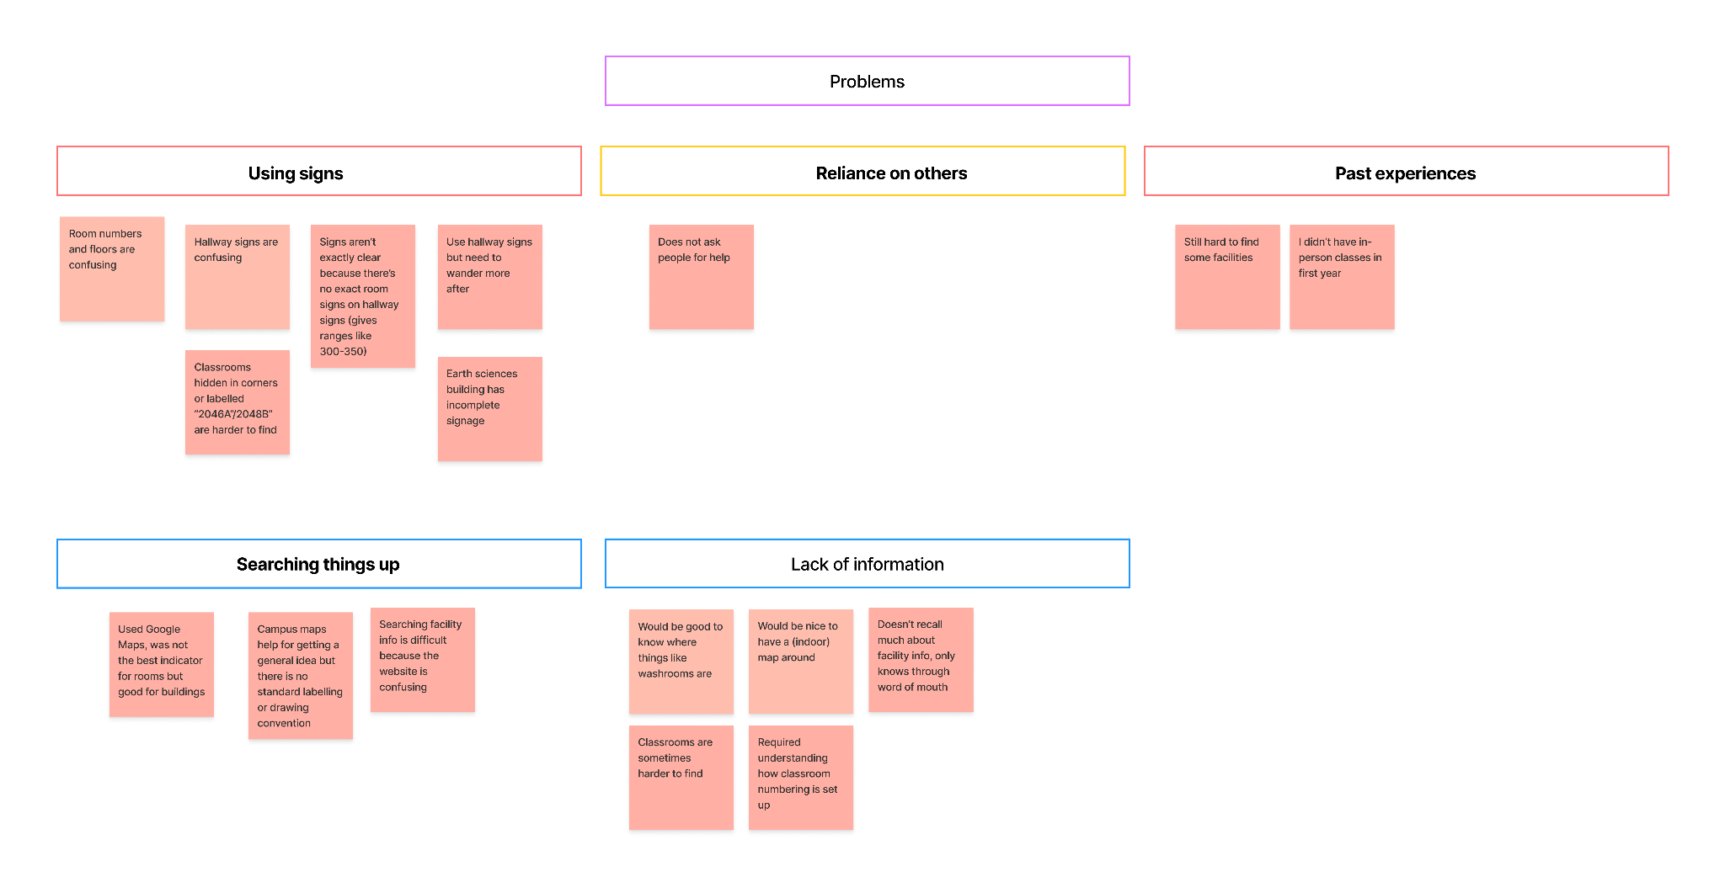
Analysis - Affinity Maps
Analysis

Slide 17
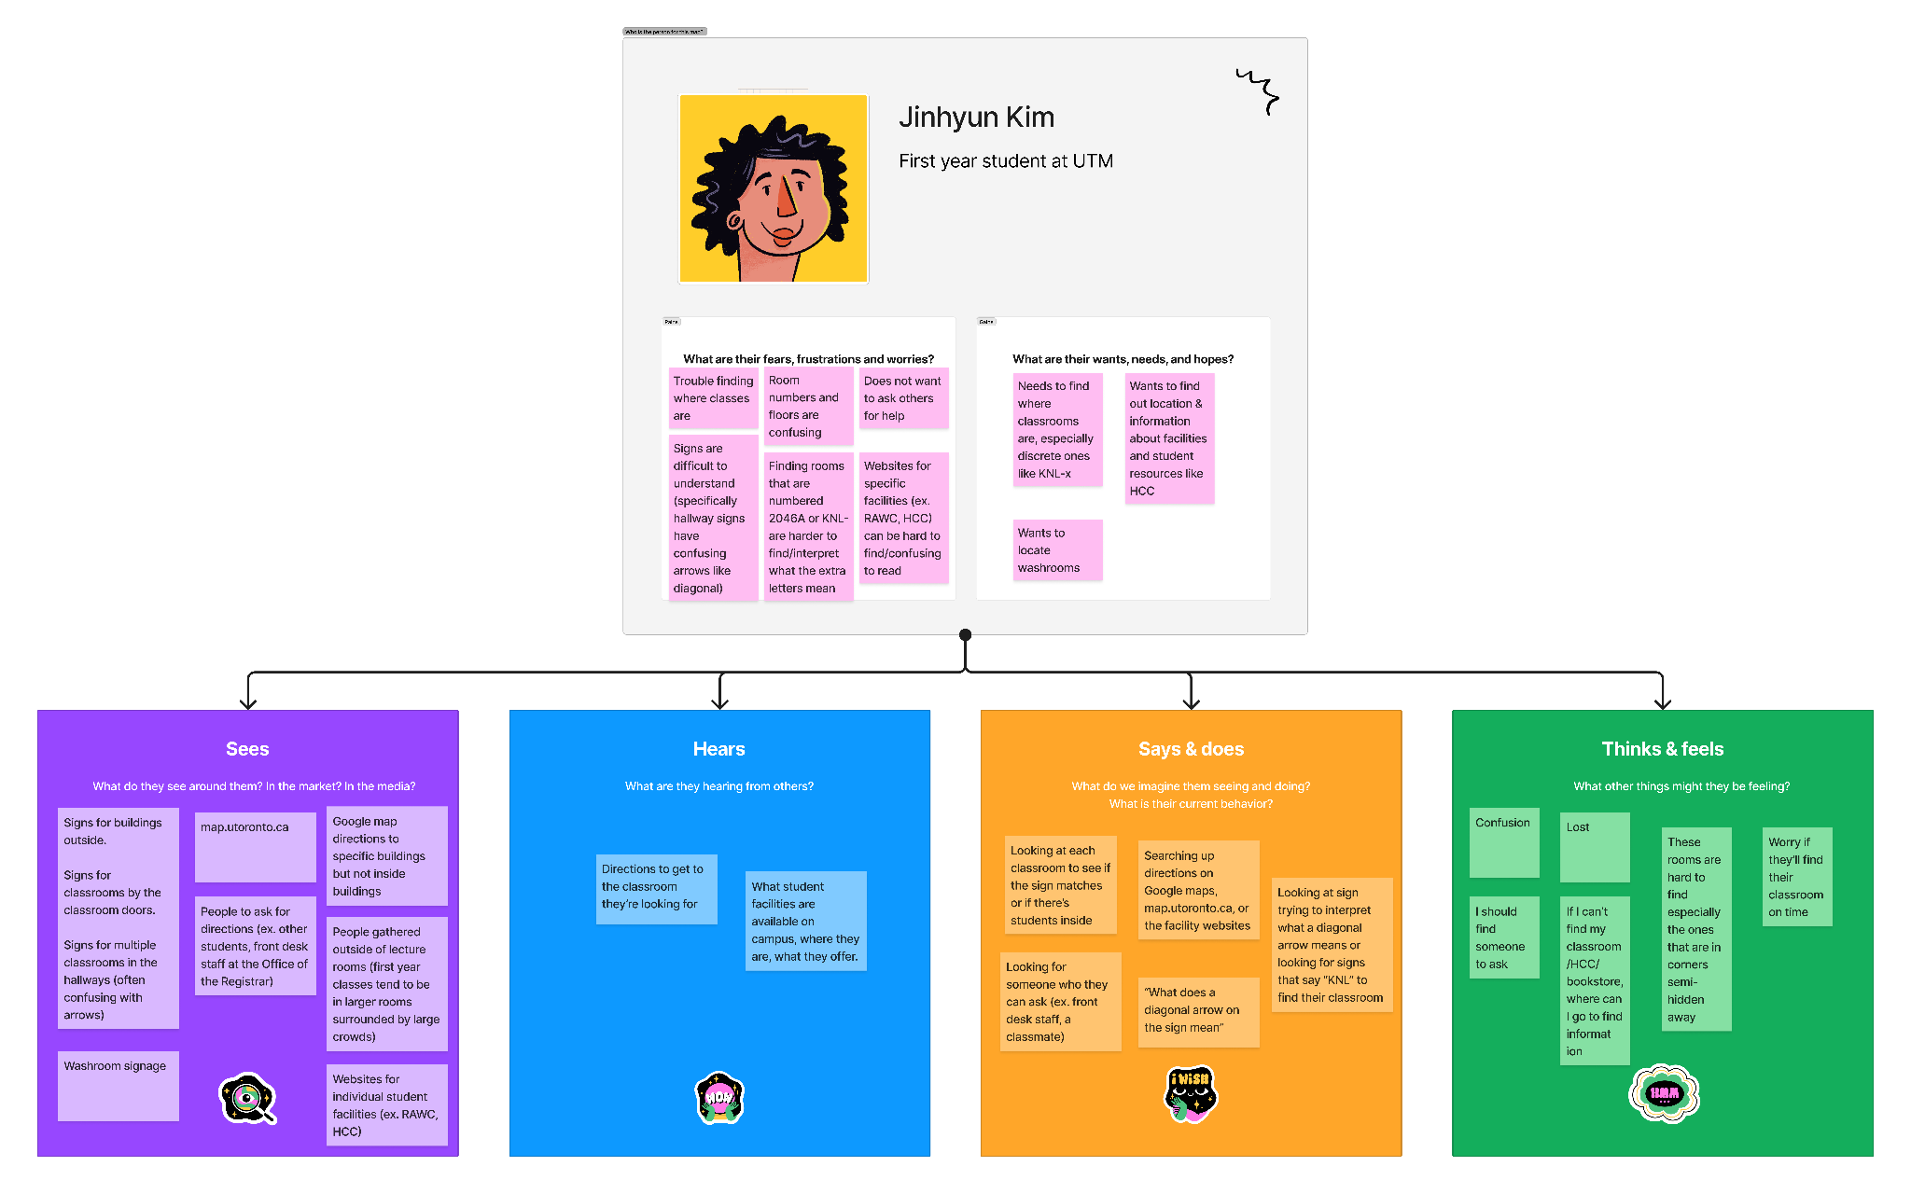
Analysis - Empathy Map
Analysis

Slide 18
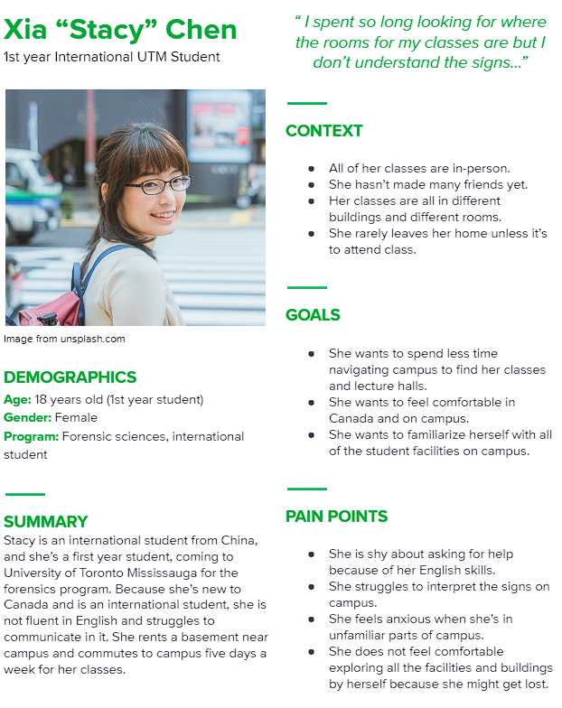
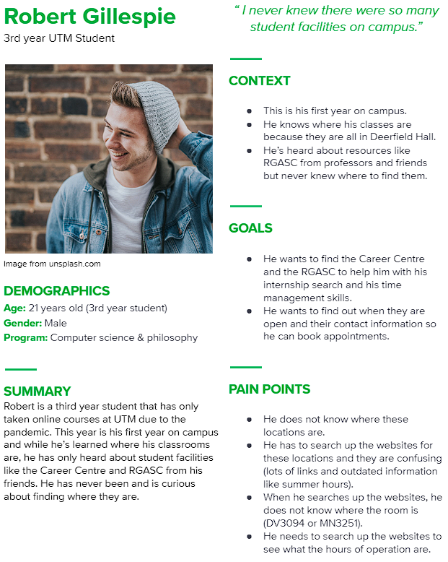
Analysis - Personas
Analysis

Slide 19

Ideation
Ideation

Slide 20
Ideation
Ideation
Problem statements
How might we & Hills
Big Ideas & Prioritization Grid
Design solution selection
(more primary research)
Must-have & Better-to-have features

Slide 21
Problem Statement
Signs are unclear
Provide clear directions & information
Lack of/difficulty finding info on facilities
Centralize it

Slide 22
How Might We
Ideation
help lost UTM students get to class on time when they cannot ask for help?
How might we
guide lost UTM students to class when the signs are confusing for them?
How might we
give UTM students information about campus facilities when they do not have anyone to tell them?
How might we
make UTM students feel confident they are going the right way to their classroom?
How might we

Slide 23
Hills
Ideation
UTM students
Can get directions to their classroom
&
Can get information about student facilities
On a centralized platform
Who
What
Wow

Slide 24
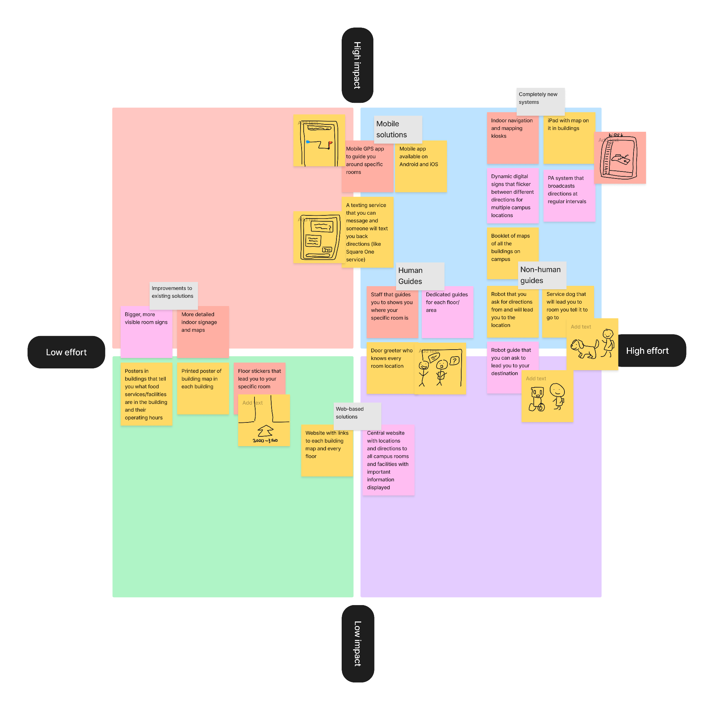
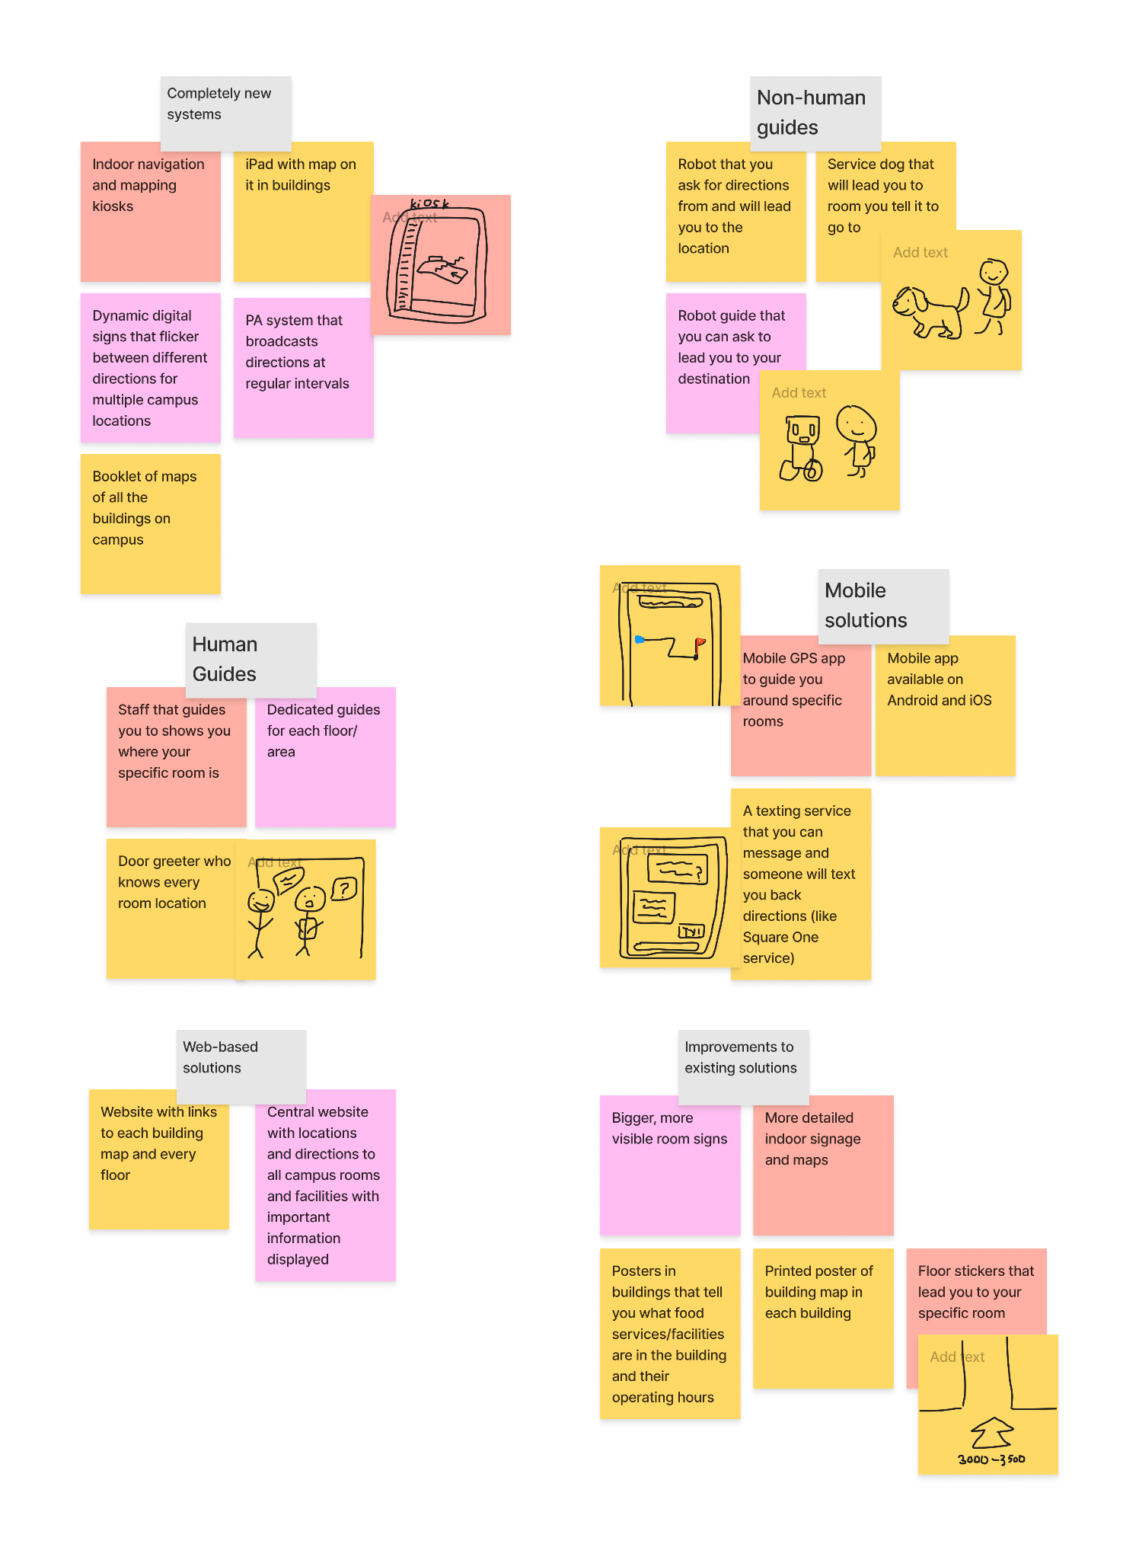
Big Ideas & Prioritization Grid
Ideation

Slide 25

Mobile App Versus Kiosk
Universal Utility of The Phone?
Common Practice of Kiosks?
More Research is Needed!

Slide 26
Design Solution Selection
Ideation
Primary Research
Feature Capability
75% of participants preferred using a mobile app to navigate
GPS tracking, augmented reality
Ease-of-Access
Accessibility
Most students have smartphones & are connected to wifi
Magnification, colour-blindness, speech-to-text

Slide 27
Must-Have vs. Nice-to-Have Features
iOS & Android
Real-time GPS Tracking
Indoor Wayfinding
Augmented Reality Features
Facility Exploration & Information
Room Schedules

Slide 28
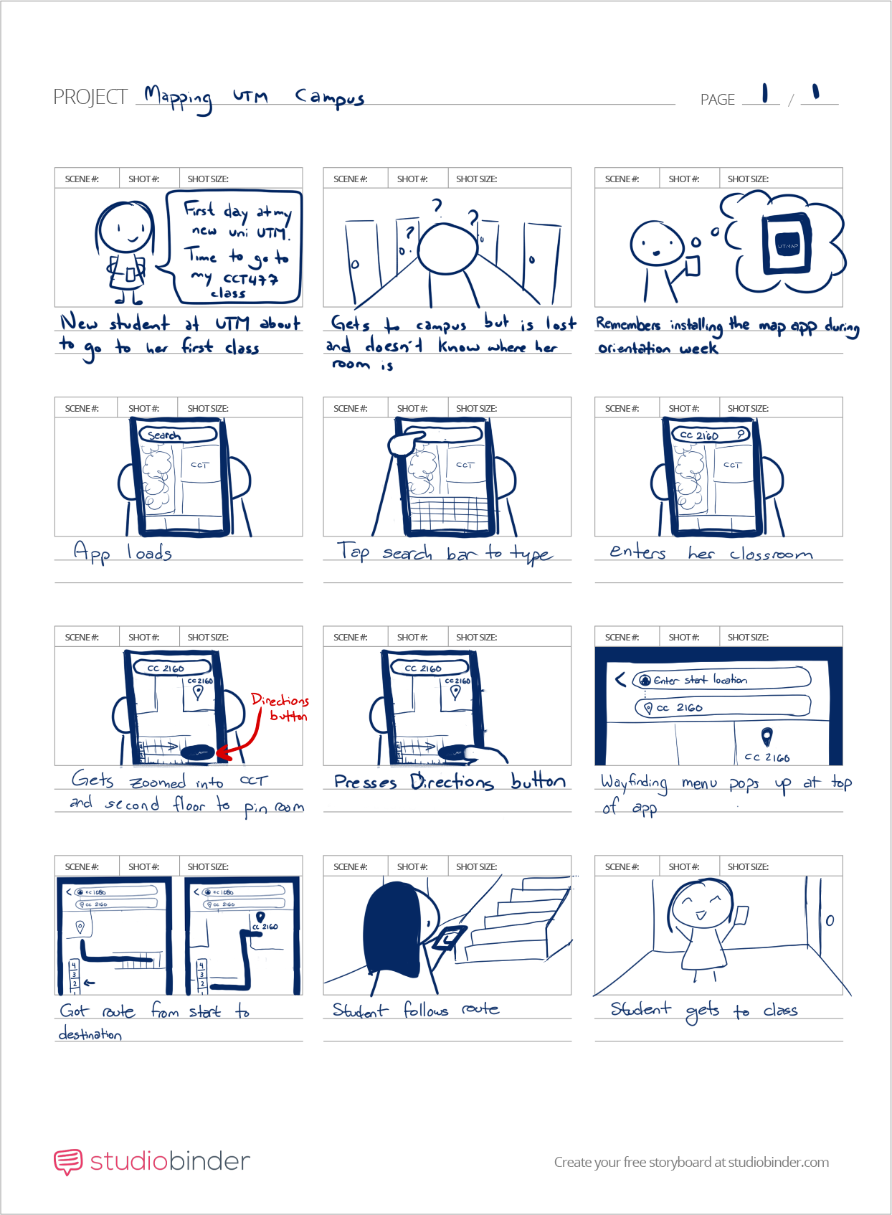

Slide 32
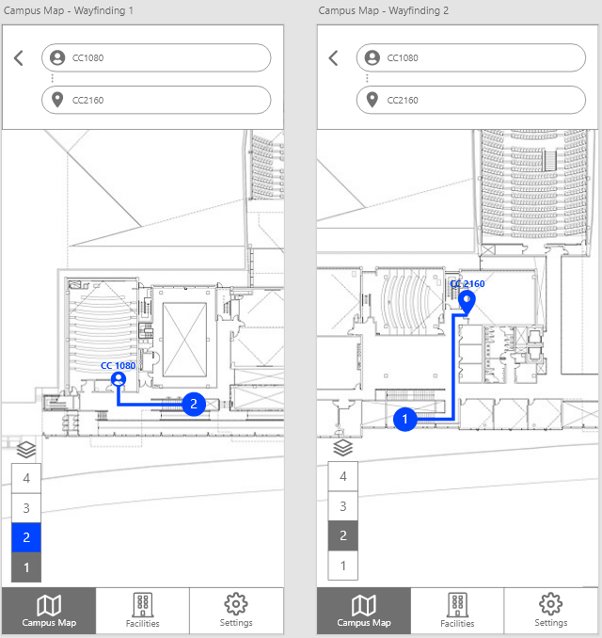
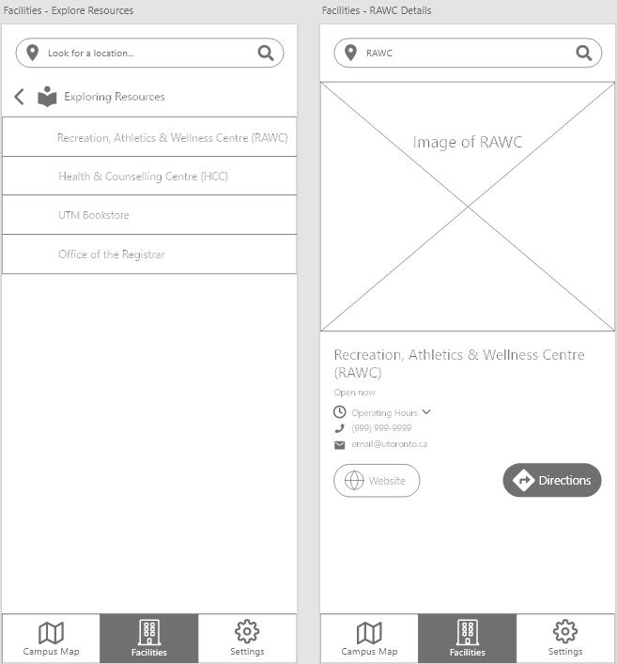
Wireframe Prototype

Slide 33
Next Steps
Increase sample size
User testing on wireframes & prototypes
Conduct research at the beginning of a semester
Explore indoor positioning system or augmented reality technology
Additional research on staff, faculty, & visitors

Slide 34

Thank you!

Slide 35
Thank you!
uwu

Slide 36
Location App Infographics
Mercury is the closest planet to the Sun and the smallest one in the Solar System
Despite being red, Mars is a cold place. The planet is full of iron oxide dust
Neptune
Mars
Jupiter
Saturn
Neptune is the farthest planet from the Sun. It’s the fourth-largest by diameter
Saturn is the ringed one. It’s a gas giant, composed mostly of hydrogen and helium

Slide 37
Location App Infographics
Mars
Jupiter
Despite being red, Mars is a cold place
It’s the biggest planet in the Solar System
Neptune
Mercury
Saturn
Neptune is the farthest planet from the Sun
Mercury is the closest planet to the Sun
Saturn is the ringed one and a gas giant

Slide 38
Nice to Have and Must Have Features
Saturn is the ringed one and a gas giant
Jupiter is the biggest planet of them all
Neptune is the farthest planet from the Sun
Venus is the hot and volcanic planet
Despite being red, Mars is a cold place
Mercury is the closest planet to the Sun

Slide 39
Our Design Proposal
Mercury
Mercury is the closest planet to the Sun and the smallest one in the Solar System
Mars
Despite being red, Mars is a cold place. The planet is full of iron oxide dust
Saturn
Saturn is the ringed one. It’s a gas giant, composed mostly of hydrogen and helium

Slide 40
Research
Mars
Despite being red, Mars is a cold place. The planet is full of iron oxide dust
Mercury
Mercury is the closest planet to the Sun and the smallest one in the Solar System
Venus
Venus has a beautiful name and is the second planet from the Sun. It’s terribly hot
Neptune
Neptune is the farthest planet in the Solar System. It’s the fourth-largest by diameter

Slide 41
Location App Infographics
Mercury
Mars
Mercury is the closest planet to the Sun and the smallest one in the Solar System
Despite being red, Mars is a cold place. The planet is full of iron oxide dust
Neptune
Saturn
Neptune is the farthest planet from the Sun. It’s the fourth-largest by diameter
Saturn is the ringed one. It’s a gas giant, composed mostly of hydrogen and helium

Slide 42
Location App Infographics
Mercury
Mars
Mercury is the closest planet to the Sun and the smallest one in the Solar System
Despite being red, Mars is a cold place. The planet is full of iron oxide dust
Neptune
Saturn
Neptune is the farthest planet from the Sun. It’s the fourth-largest by diameter
Saturn is the ringed one. It’s a gas giant, composed mostly of hydrogen and helium

Slide 43
Location App Infographics
Mars
Despite being red, Mars is a cold place. The planet is full of iron oxide dust
Mercury
Mercury is the closest planet to the Sun and the smallest one in the Solar System
Venus
Venus has a beautiful name and is the second planet from the Sun. It’s terribly hot

Slide 44
Location App Infographics
Mars
Saturn is the ringed one. It’s composed mostly of hydrogen and helium
Despite being red, Mars is a cold place. The planet is full of iron oxide dust
Saturn
Jupiter
Venus has a beautiful name and is the second planet from the Sun
Jupiter is a gas giant and the biggest planet in the Solar System
Venus

Slide 45
Location App Infographics
Mercury
Jupiter
Mercury is the closest planet to the Sun
It’s the biggest planet in the Solar System
43 min
650 cal
Venus
Saturn
Venus has a beautiful name, but it’s terribly hot
Saturn is the ringed one and a gas giant
7.4 km
165 bpm

Slide 46
Location App Infographics
Mercury
Mars
Mercury is the closest planet to the Sun
Despite being red, Mars is a cold place
Neptune
Saturn
Neptune is the farthest planet from the Sun
Saturn is the ringed one and a gas giant

Slide 47
Location App Infographics
Mercury
Mercury is the closest planet to the Sun and the smallest one in the Solar System
Neptune
Neptune is the farthest planet from the Sun. It’s the fourth-largest by diameter
Mars
Despite being red, Mars is a cold place. The planet is full of iron oxide dust
Saturn
Saturn is the ringed one. It’s a gas giant, composed mostly of hydrogen and helium

Slide 48
Location App Infographics
Saturn
Earth
Saturn has several rings
Earth is the only planet with life
Moon
Venus
The Moon is a satellite
Venus has a beautiful name
Mars
Mercury
Despite being red, Mars is cold
Mercury is the smallest planet

Slide 49
Location App Infographics
Mars
Despite being red, Mars is a cold place
Mercury
Mercury is the second planet from the Sun
Saturn
Saturn has several rings and is a gas giant
Neptune
Neptune is the farthest planet from the Sun

Slide 50
Location App Infographics
35%
75%
Mercury
Mars
Mercury is the closest planet to the Sun and the smallest one in the Solar System
Despite being red, Mars is a cold place. The planet is full of iron oxide dust
Neptune
Saturn
Neptune is the farthest planet from the Sun. It’s the fourth-largest by diameter
Saturn is the ringed one. It’s a gas giant, composed mostly of hydrogen and helium
65%
20%

Slide 51
Location App Infographics
Saturn is the ringed one and a gas giant
Jupiter is the biggest planet of them all
Neptune is the farthest planet from the Sun
Venus has a beautiful name, but it’s very hot
Despite being red, Mars is a cold place
Mercury is the closest planet to the Sun

Slide 52
Analysis
Analysis
2.1 km
46 min
Mercury
Mars
Mercury is the closest planet to the Sun and the smallest one in the Solar System
Despite being red, Mars is a cold place. The planet is full of iron oxide dust
10 km
42 min
74 km
2 h 18 min
Neptune
Saturn
Neptune is the farthest planet from the Sun. It’s the fourth-largest by diameter
7 Km
58 min
Saturn is the ringed one. It’s a gas giant, composed mostly of hydrogen and helium

Slide 53
Location App Infographics
Mercury
Mars
Mercury is the closest planet to the Sun and the smallest one in the Solar System
Despite being red, Mars is a cold place. The planet is full of iron oxide dust
Neptune
Saturn
Neptune is the farthest planet from the Sun. It’s the fourth-largest by diameter
Saturn is the ringed one. It’s a gas giant, composed mostly of hydrogen and helium

Slide 54
Secondary
Primary
Analysis
Ideation

Slide 55
Instructions for use (free users)
In order to use this template, you must credit Slidesgo by keeping the Thanks slide.
You are allowed to:
Modify this template.
Use it for both personal and commercial purposes.
You are not allowed to:
Sublicense, sell or rent any of Slidesgo Content (or a modified version of Slidesgo Content).
Distribute this Slidesgo Template (or a modified version of this Slidesgo Template) or include it in a database or in any other product or service that offers downloadable images, icons or presentations that may be subject to distribution or resale.
Use any of the elements that are part of this Slidesgo Template in an isolated and separated way from this Template.
Delete the “Thanks” or “Credits” slide.
Register any of the elements that are part of this template as a trademark or logo, or register it as a work in an intellectual property registry or similar.
For more information about editing slides, please read our FAQs or visit Slidesgo School:
https://slidesgo.com/faqs and https://slidesgo.com/slidesgo-school

Slide 56
Instructions for use (premium users)
In order to use this template, you must be a Premium user on Slidesgo.
You are allowed to:
Modify this template.
Use it for both personal and commercial purposes.
Hide or delete the “Thanks” slide and the mention to Slidesgo in the credits.
Share this template in an editable format with people who are not part of your team.
You are not allowed to:
Sublicense, sell or rent this Slidesgo Template (or a modified version of this Slidesgo Template).
Distribute this Slidesgo Template (or a modified version of this Slidesgo Template) or include it in a database or in any other product or service that offers downloadable images, icons or presentations that may be subject to distribution or resale.
Use any of the elements that are part of this Slidesgo Template in an isolated and separated way from this Template.
Register any of the elements that are part of this template as a trademark or logo, or register it as a work in an intellectual property registry or similar.
For more information about editing slides, please read our FAQs or visit Slidesgo School:
https://slidesgo.com/faqs and https://slidesgo.com/slidesgo-school

Slide 57
Infographics
You can add and edit some infographics to your presentation to show your data in a visual way.
Choose your favourite infographic and insert it in your presentation using Ctrl C + Ctrl V or Cmd C + Cmd V in Mac.
Select one of the parts and ungroup it by right-clicking and choosing “Ungroup”.
Change the color by clicking on the paint bucket.
Then resize the element by clicking and dragging one of the square-shaped points of its bounding box (the cursor should look like a double-headed arrow). Remember to hold Shift while dragging to keep the proportions.
Group the elements again by selecting them, right-clicking and choosing “Group”.
Repeat the steps above with the other parts and when you’re done editing, copy the end result and paste it into your presentation.
Remember to choose the “Keep source formatting” option so that it keeps the design. For more info, please visit Slidesgo School.

